Slide 1
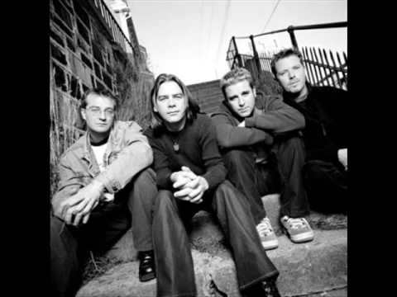
THE NORTH ATLANTIC AND THE FISHING INDUSTRY
Eric Campos, Carolina Coguox, Matthew Lostetter, Shayna Michael, Mayra Pacheco, Jose Pinzon

Slide 2
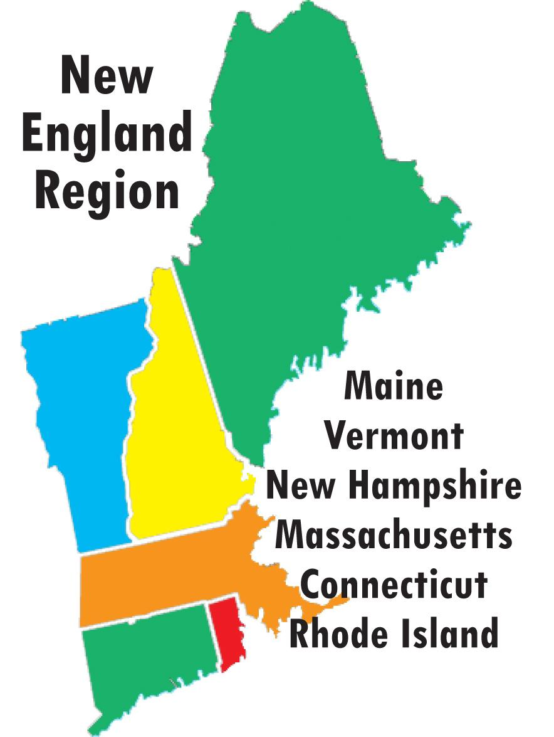
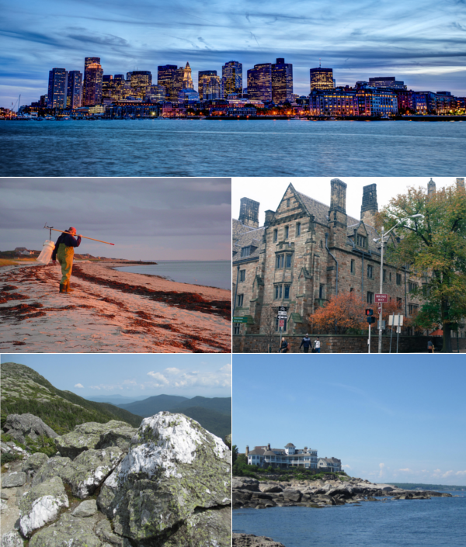

Slide 3
History
The Irish, English, and Scots settled the North Atlantic region
French Acadians settled the Maritimes
Native American Algonquian and Iroquoian families lived in northern New England
Eastern Woodland Micmac dominant in Maritime Provinces
Beotuks dominated Newfoundland
Many of the Natives began trading with French fishers in the early 1500’s
Permanent European settlement of Newfoundland began in 1610

Slide 4
Geography
New England’s geography offers immense diversity. The region is bounded to the north by Canada, to the east by the Atlantic Ocean, to the south by Long Island Sound, and to the west by the state of New York. There are rivers and lakes, towering forests, mountain ranges with hiking and skiing trails, pastoral farmland and countryside, and dramatic rocky coastline and soft, sandy beaches.

Slide 5
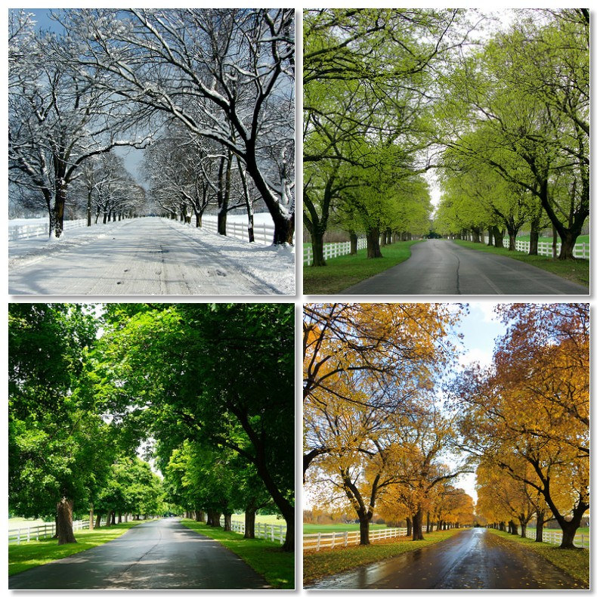
Climate
Summer (Late June, July, August)
*Average temperature 80-85 ℉
Fall (September through early November)
*Avg. temp. 45-50 degrees ℉
Winter (mid-November through end of March)
*Avg. temp. 45-50 ℉
*Snowfall: Southern New England snowfall averages around 35 inches per year while the upper mountainous regions often receive over 100 inches annually
Spring (April, May, early June)
*Avg. temp. 40-60 ℉

Slide 6




Ivy League
Harvard
Yale
Harvard University, oldest institution of higher learning in the United States (founded 1636) and one of the nation’s most prestigious. It is one of the private Ivy League schools. The main university campus lies along the Charles River in Cambridge, Massachusetts, a few miles west of downtown Boston.
It was founded in 1701 and is the third oldest university in the United States. Private Ivy League school in New Haven, Connecticut. In 1716 the school was moved to New Haven, and in 1718 it was renamed Yale College in honour of a wealthy British merchant and philanthropist, Elihu Yale, who had made a series of donations to the school

Slide 7
NEW ENGLAND
Cape Cod– once named after its abundant cod fishing industry has largely diminished
Today, its economies are centered in megalopolis’s
On the periphery, the scenic landscape is a hub of rurality and vacation homes.
The youth of the region are increasingly leaving due to various push factors.

Slide 8
Northern New England: Vermont
Vermont: Meaning “Green Mountain” in French
The once mountainous landscape of Vermont/New Hampshire have become degraded from erosion.
Monadnock: Isolated hills of bedrock, left as erosional remnants because of their resistant rock composition.

Slide 9
Economic Trends and Environmental Effects in Vermont.
The Vermont economy was once built around dairy farming-- since the 1940’s the number of dairy farms have declined.
Dairy farming remains productive despite small number of farms-- this is due to dairy production becoming concentrated in fewer farms.
The decline of farming has allowed for the regrowth of forests-- up from 37% in the 1880’s to 78%

Slide 10
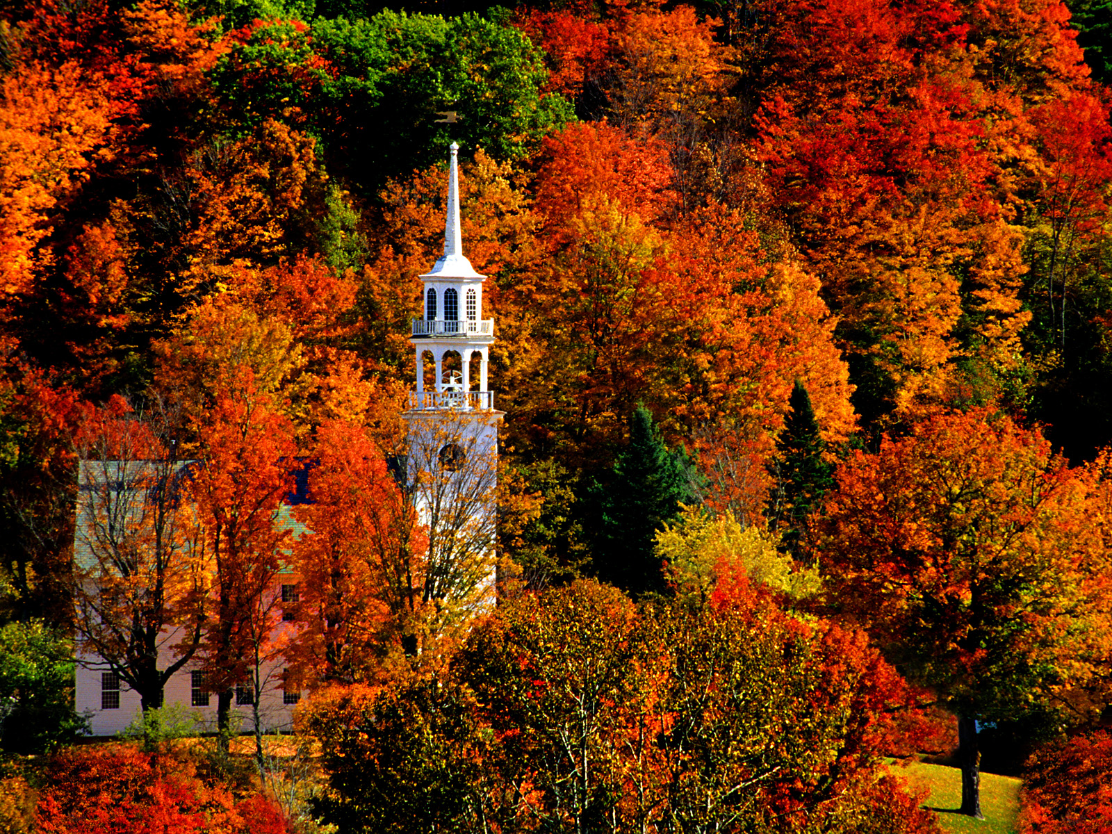

Slide 11
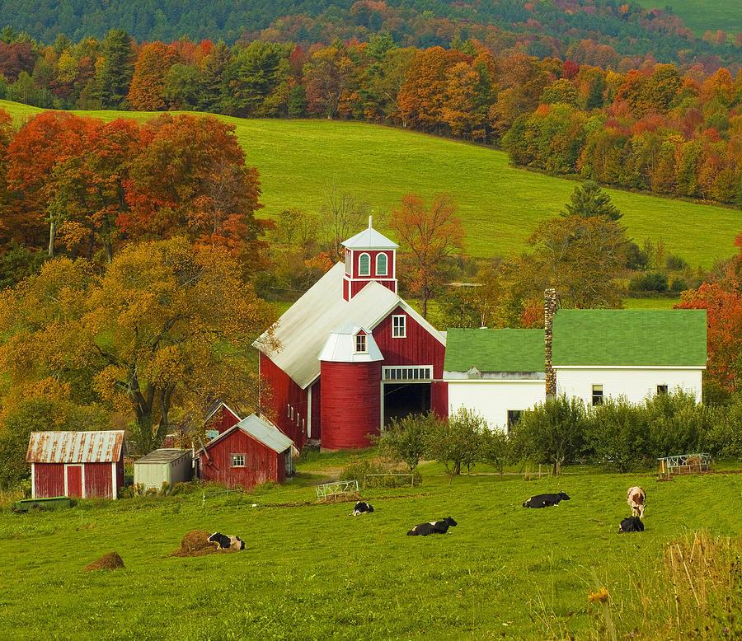

Slide 12
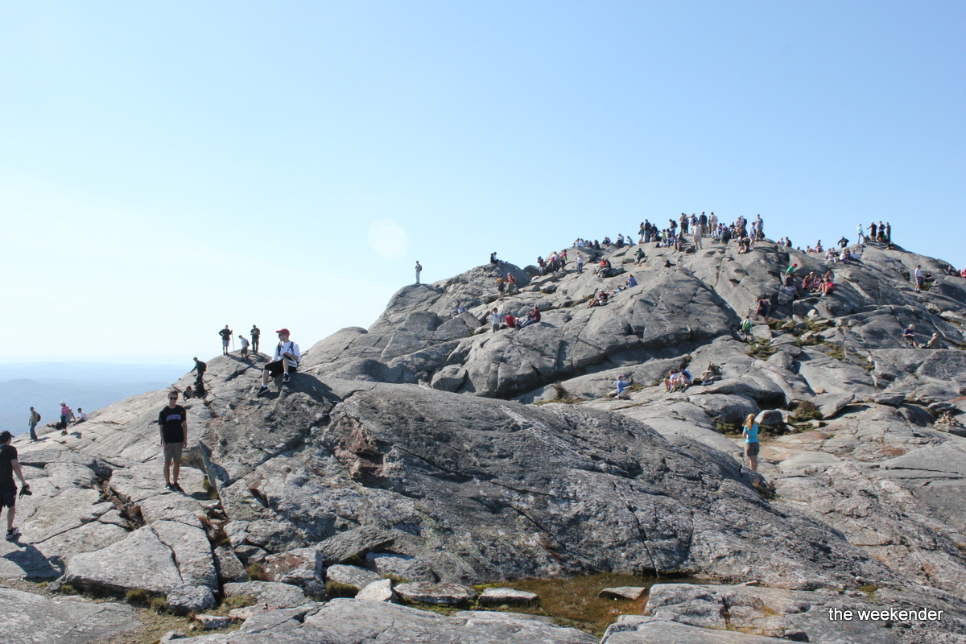

Slide 13
Decline of the Fishing Industry
The problems faced by the fishing industry is a classic example of the “tragedy of the commons”
Short term profit seeking has led to long term sustainability to be ignored
Local out-port fishing shifted towards factory fishing

Slide 14
Economic Resources
The Poor Soil Quality of the North Atlantic regions has lead to an economy based on few resources.
Of these resources the two primary ones have historically been: Lumber and Fish

Slide 15
Over time both industries experienced decline brought on by unsustainable practices and changing economic trends
Overfishing lead to a collapse of the Cod fishing industry in 1993
Lumber collapsed as regional manufacturing shut down– leaving the region economically isolated.

Slide 16
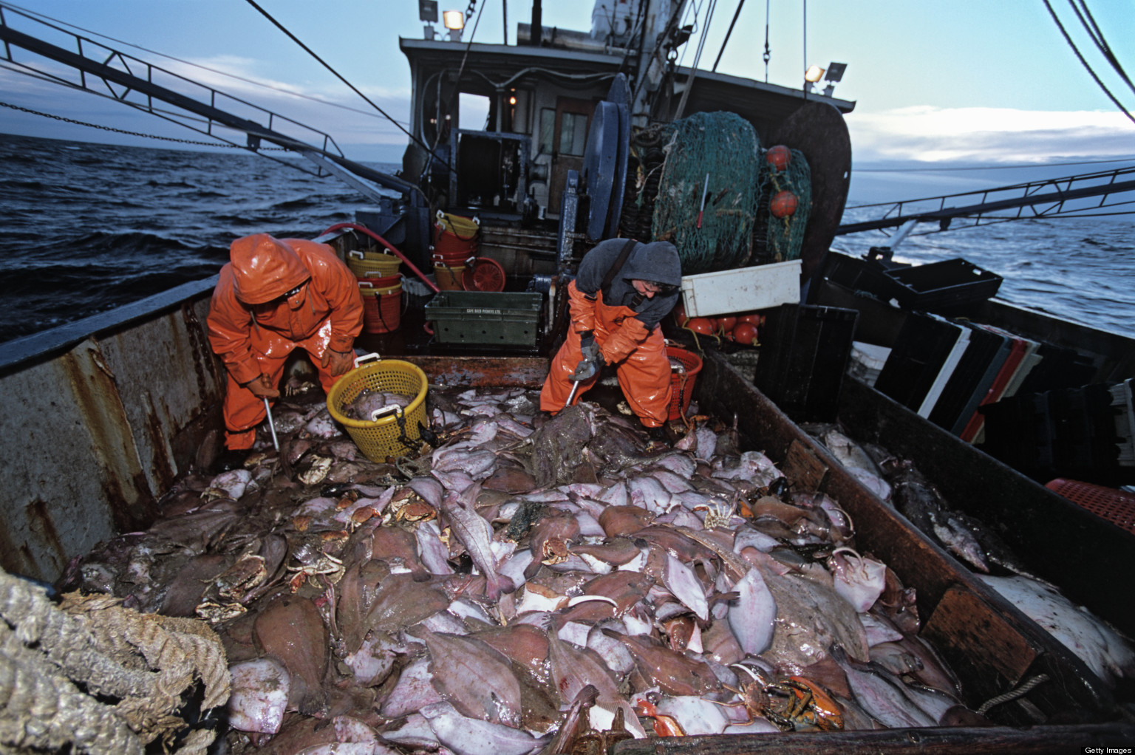

Slide 17

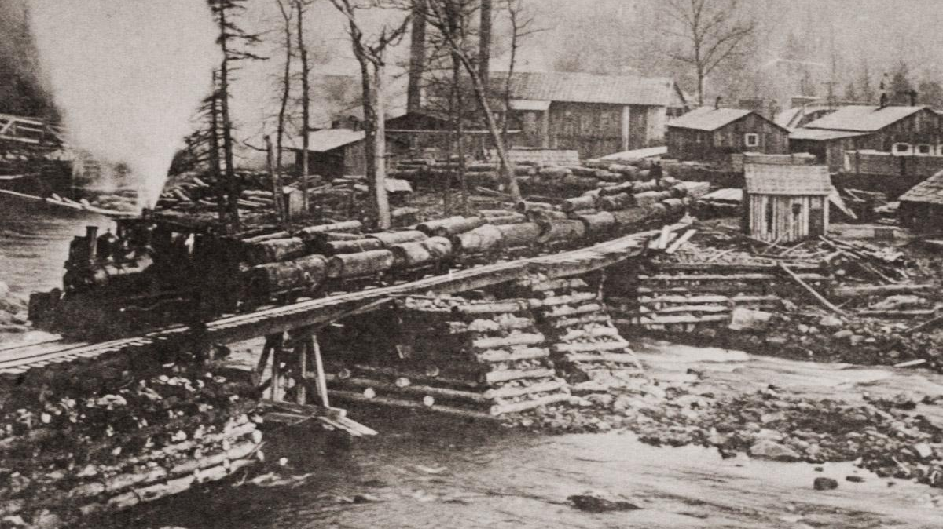

Slide 18
NEW ALTERNATIVES
Offshore drilling has emerged as a short-term solution.
Other alternatives are emerging across the region– some incorporating ideas on sustainability and cleaner energy sources

Slide 19
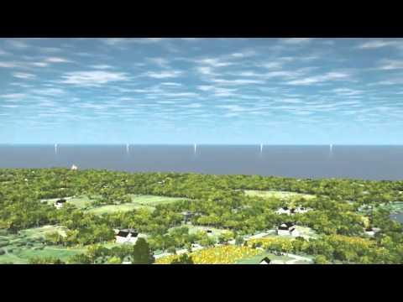
Ocean Frontiers II: A New England Story for Sustaining the Sea
Video talks about wind power but the problem of an already overcrowded sea, although the new wind power would decrease greenhouse levels there are still other problems to keep in mind.
7:45 - 10:45

Slide 20
United states: Those in peril off the sea; New England's fishing industry.
Professional Journal
United states: Those in peril off the sea; new england's fishing industry. (2011, Feb 12). The Economist, 398, 38
http://csulb.idm.oclc.org/login?url=https://search.proquest.com/docview/851481797?accountid=10351
New Bedford is the nation's principal fishing port in terms of landed value. To prevent overfishing and to allow fish stocks to rebuild, federal officials set up a new regulation system last year. Many fishermen think the new limits are unreasonably low. Two-thirds of New Bedford's boats have not left harbour since August.

Slide 21
Bigger populations needed for sustainable harvests
Professional Journal
Greene, K. (2002). Bigger populations needed for sustainable harvests. Science, 296(5571), 1229-30.
http://csulb.idm.oclc.org/login?url=https://search.proquest.com/docview/213575718?accountid=10351
The future of the New England fishing industry rests on the willingness of fishers, environmentalists, scientists, and the courts to find common ground. Scientists hope to replicate the success of a New England Fishery Management Council plan that helped restore the area's scallop industry with similar calculations for the much larger groundfish industry.

Slide 22
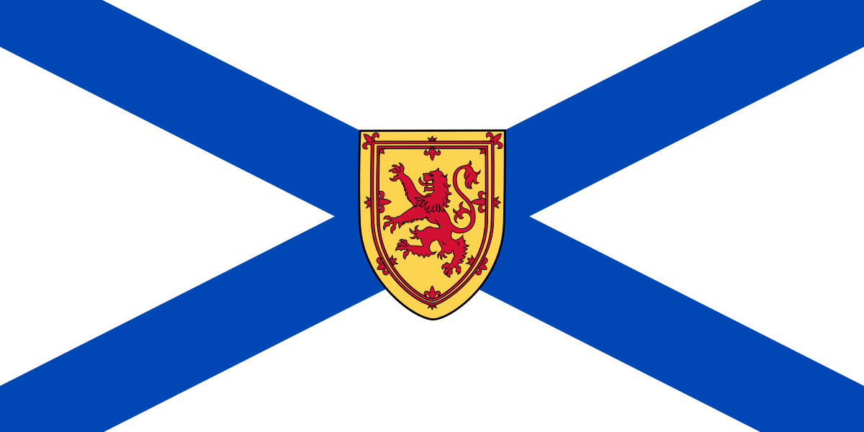
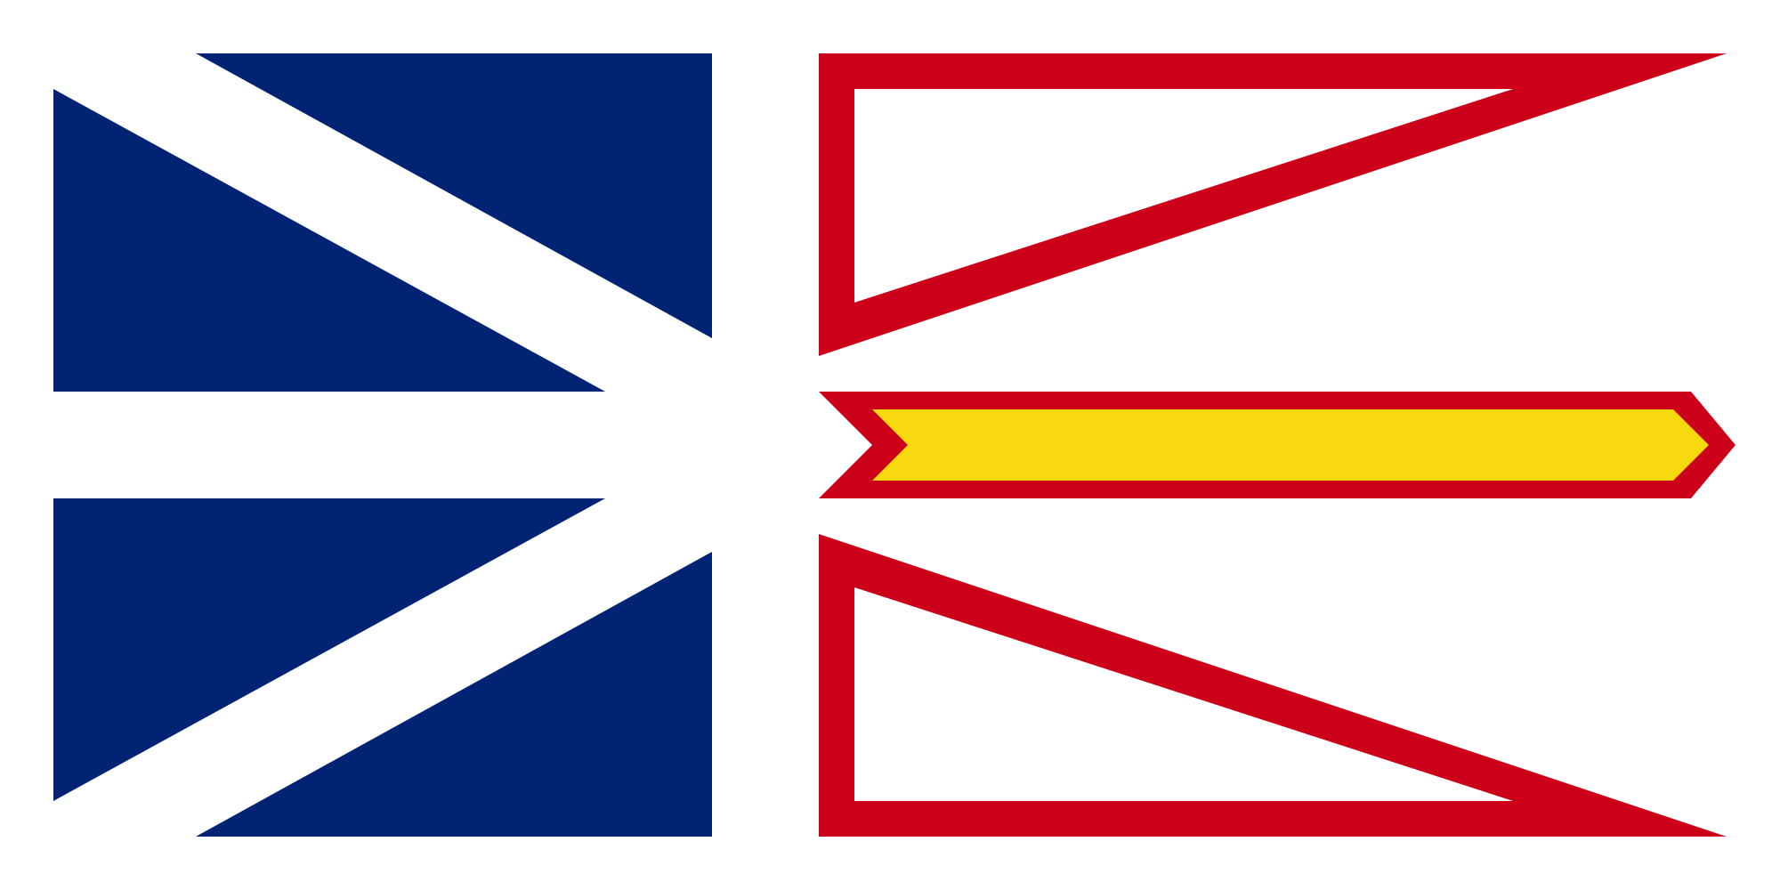
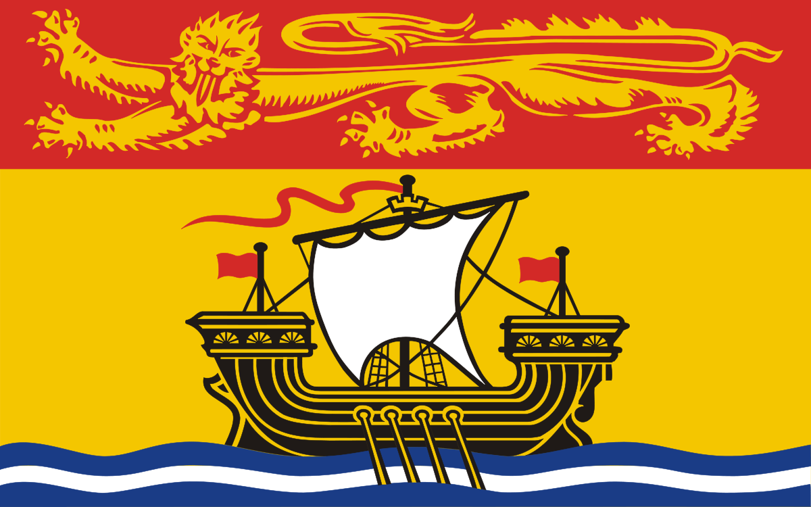
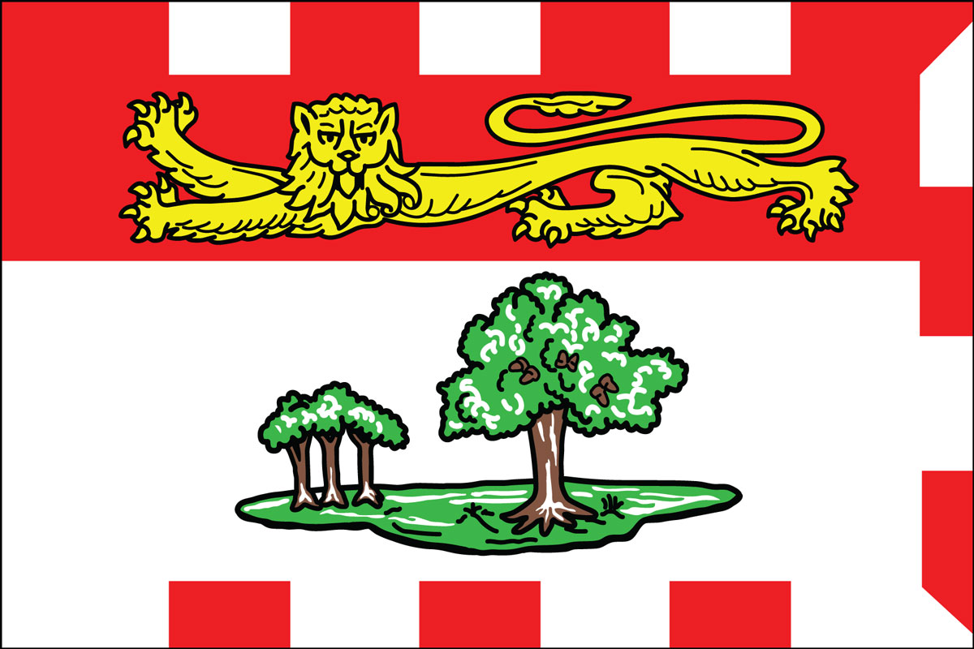
Nova Scotia
Newfoundland and Labrador
North Atlantic Provinces
Prince Edward Island
New Brunswick

Slide 23
Newfoundland Physical Geography
Fjords and deep harbors indent the coastlines
Moss and lichens inhabit the inland while people concentrate along the coastline.
The Labrador Current brings cold air from the arctic onto the region.

Slide 24
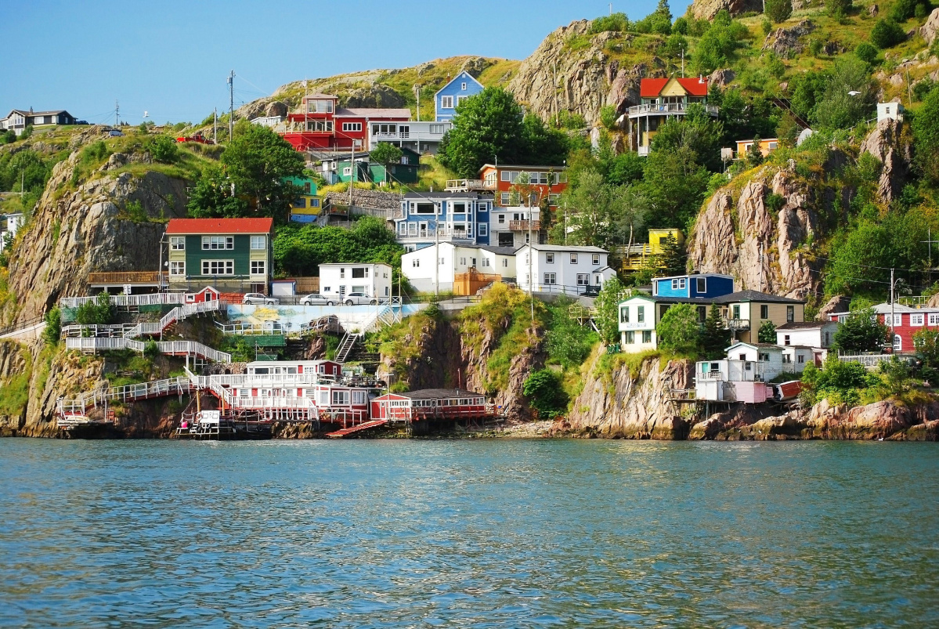

Slide 25
Newfoundland
Original settlements were “outports”-- small scale fishing communities.
Outports were established for curing fresh fish to dried cod.
Following the collapse of the cod industry, outports suffered economic devastation and the majority of the people were forced to move.

Slide 26
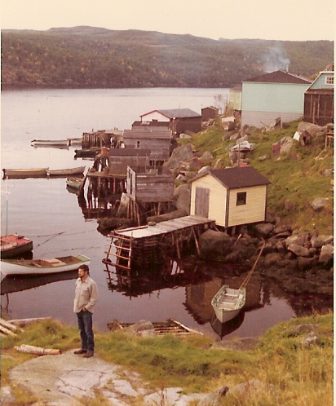
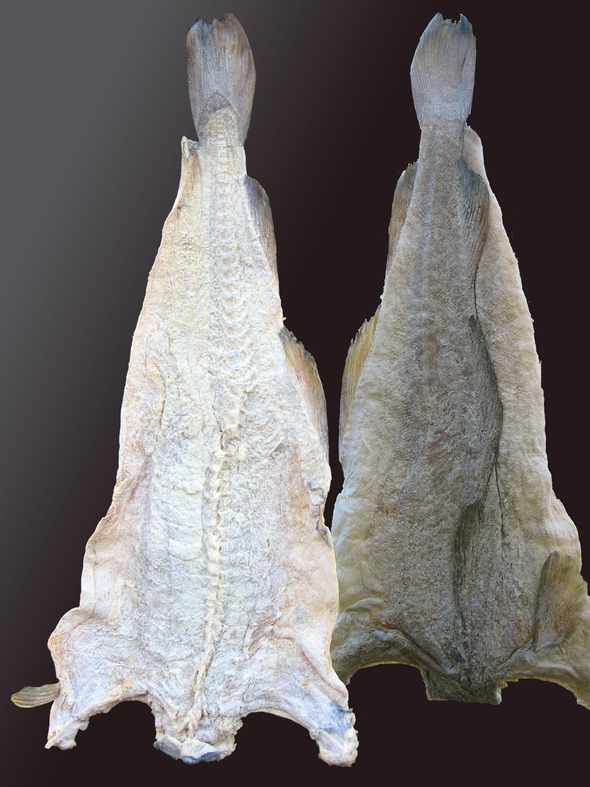

Slide 27
Settlement
Europeans landed on Newfoundland in 988.
Permanent European settlement on the Newfoundland did not happen till 1610 and by the mid-eighteenth century more than seven thousand settlers lived in hundreds of coast-hugging outports.
The Newfoundland was given up to Britain after the 1713 Treaty of Utrecht. They were the lands closest trade ties.
The deal that would have made them part of the United States was unsuccessful so they became independent in 1855.

Slide 28
Settlement Continued...
The Atlantic Provinces
The pre-columbian fishing crews plied the Grand Banks, the first Europeans to permanently settle the Atlantic Provinces were the Acadians. During the early 1600’s, English, Scots,and Irish fishers settled in Newfoundland and along the North Atlantic coast.
Acadia
In 1604 Northern French settlers arrived in the Bay of Fundy, which they ended calling Acadia. Their cultural preadaptation to the new land gave them survival traits that allowed them to build a farming, fishing, nd lumbering economy in their new environment.

Slide 29
Acadia cont...
The Acadian people refused to trade with or sign an oath of allegiance to the British so they Acadians were removed by force between 1755 and 1763.
They were deported to British colonies, France, or other colonies, and others became refugees in the inland forests of their former homes.
The people who came to replace the Acadians were the British and Scot settlers.

Slide 30
Northern New England Settlement
What brought settlers into Northern New England was fishing along the Grand, Scotian, or Georges banks, trade with Britain was close, and shipbuilding.
In the 1600’s, fishers and Puritans from Massachusetts settled in the colony of New Hampshire while the French entered Vermont.
Vermont was the first state outside the 13 original colonies to join the United States of America after being a republic from 1777-1791.

Slide 31
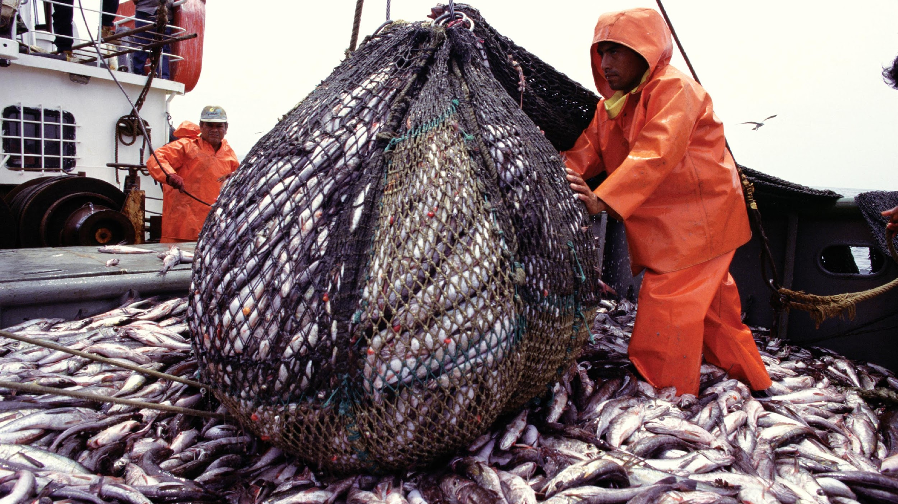

Slide 32
Regional Life
Population
Since the 1920’s young adults have been seeing jobs decrease and emigration increase in the North Atlantic regional population.
The meager population supports few cities in Northern New England and Atlantic Canada.
In Newfoundland and Nova Scotia, four out of five residents live in small spread out coastal villages and in PEI almost everyone lives within six miles of the coast.
Only in New Brunswick do people live inland in cities along the rivers.

Slide 33
Regional Life Cont…. Newfoundland
In the Newfoundland the fishery collapse left most outport residents unemployed and few jobs were in commuting distance because of many outports being inaccessible by road.
From 1994 to 2007 they lost a total of seventy- one thousand people due to the fishery collapse.
Almost every outport lost population including the major cities and the capital.
The only thing that saved their population and economy after the downfall was the oil resources which made the economy grow 50 percent between 2000 and 2008.

Slide 34
Maritimes
The Maritimes and Newfoundland together made up 7 percent of Canada in 2011 which makes up the second smallest population next to Atlantic Canada in the North.
The collapse of the fishery continues to affect Newfoundland’s population until 2007, when offshore oil drilling began to resurge.
During the latter years of the eighteenth century, fifty-five thousand British, Scots, Irish, and Welsh emigrants settled in Nova Scotia.

Slide 35
The Grand Seduction (2013)
The Grand Seduction was a Canadian comedy released in 2013 about life in a rural Newfoundland fishing village
Film deals with the collapse of the local fishing industry and the villagers attempts to save their village
The plot involves convincing a doctor from urban Canada to become the village doctor so that the village can receive a factory that would provide jobs for the villagers who have been unemployed since the collapse of the fishing industry
The film stars many of Newfoundland’s most well-known actors including Gordon Pinsent and Mark Critch

Slide 36
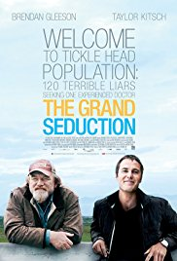
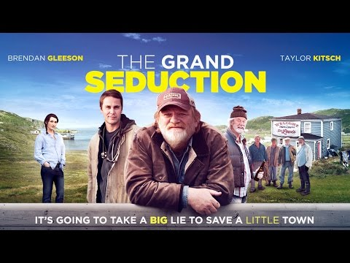

Slide 37
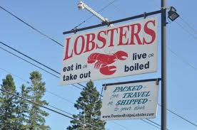
Cultural Perspectives in The North Atlantic
Cultural Artifacts
Lobster dinners and shacks
Covered Bridges are iconic and nostalgic
Almost 200 covered bridges are in North Atlantic States and 61 in New Brunswick
Symbolic Pattern
-Northeastern towns typically have a green landscape and a white-spired church

Slide 38
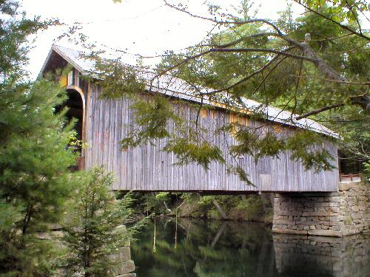
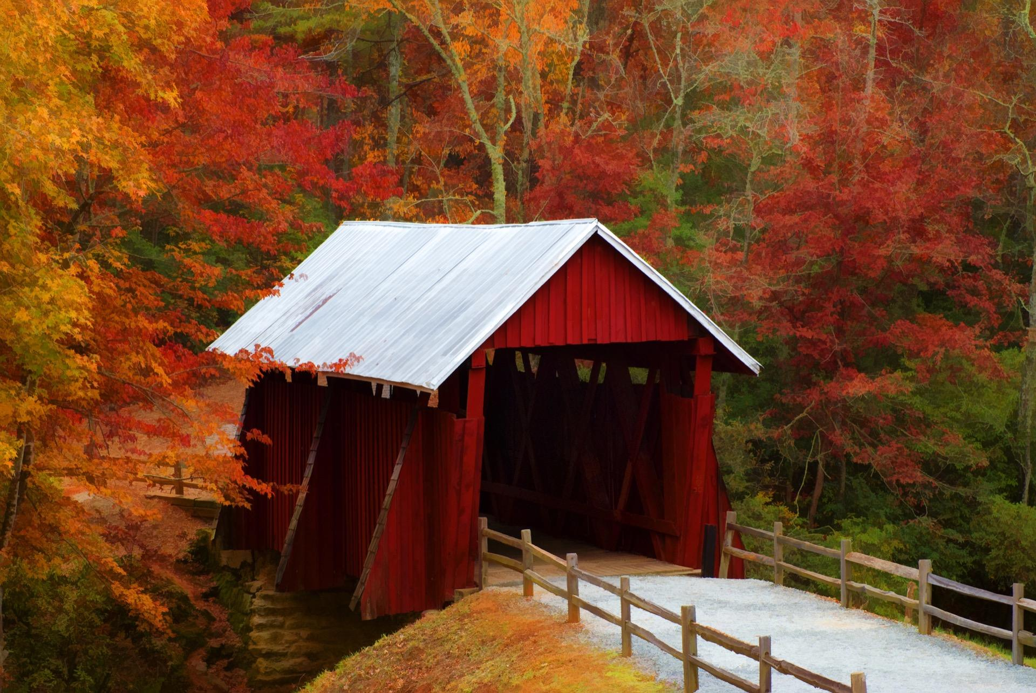

Slide 39
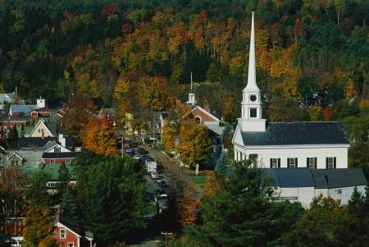
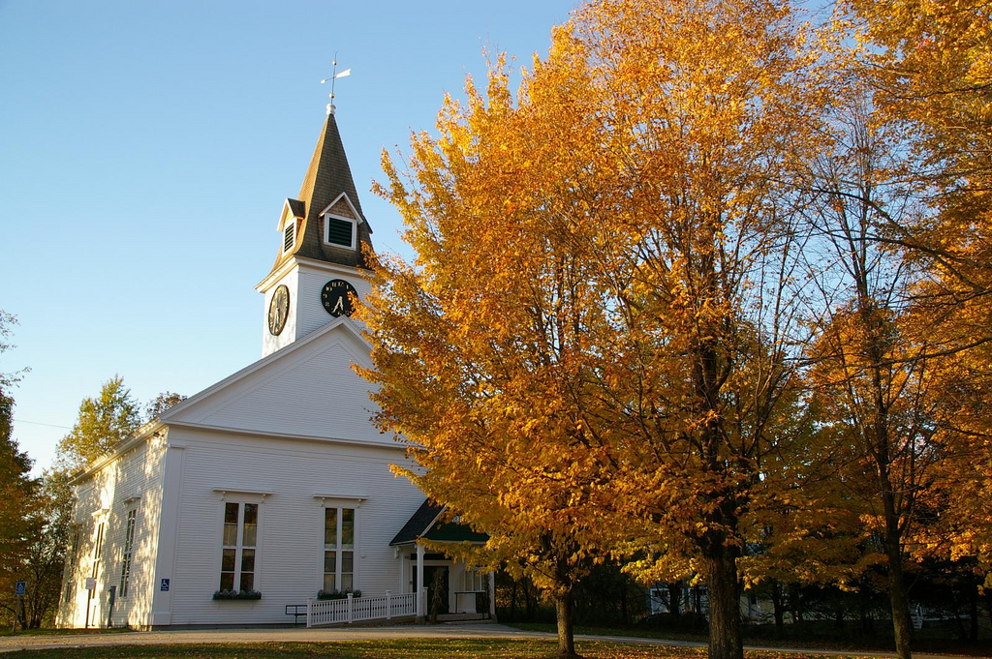

Slide 40
Cultural Perspectives in The North Atlantic
“Lobstah”
-Local pronunciation is a common food throughout the region
- In the past,Native Americans and early colonists used the crustacean as a fertilizer
-During the winters, lobsters are difficult to catch and as a result lobsters are “Pounded”caught in the previous peak season

Slide 41
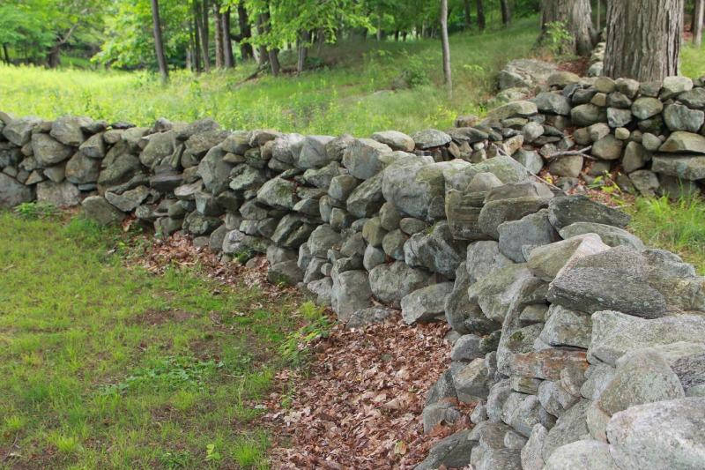
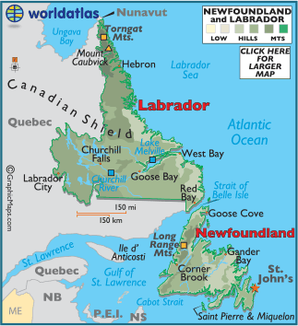
Northern New England
-Stone Walls built by European settlers are
a cultural landscape
- The term “Yankee”
Newfoundland Canada
-Isolated island
-known for a distinct English dialect brought by
the settlers
-deeply depends on fishery created a food
culture dependent on non-perishables. Fresh fruit is
rare

Slide 42


Slide 43
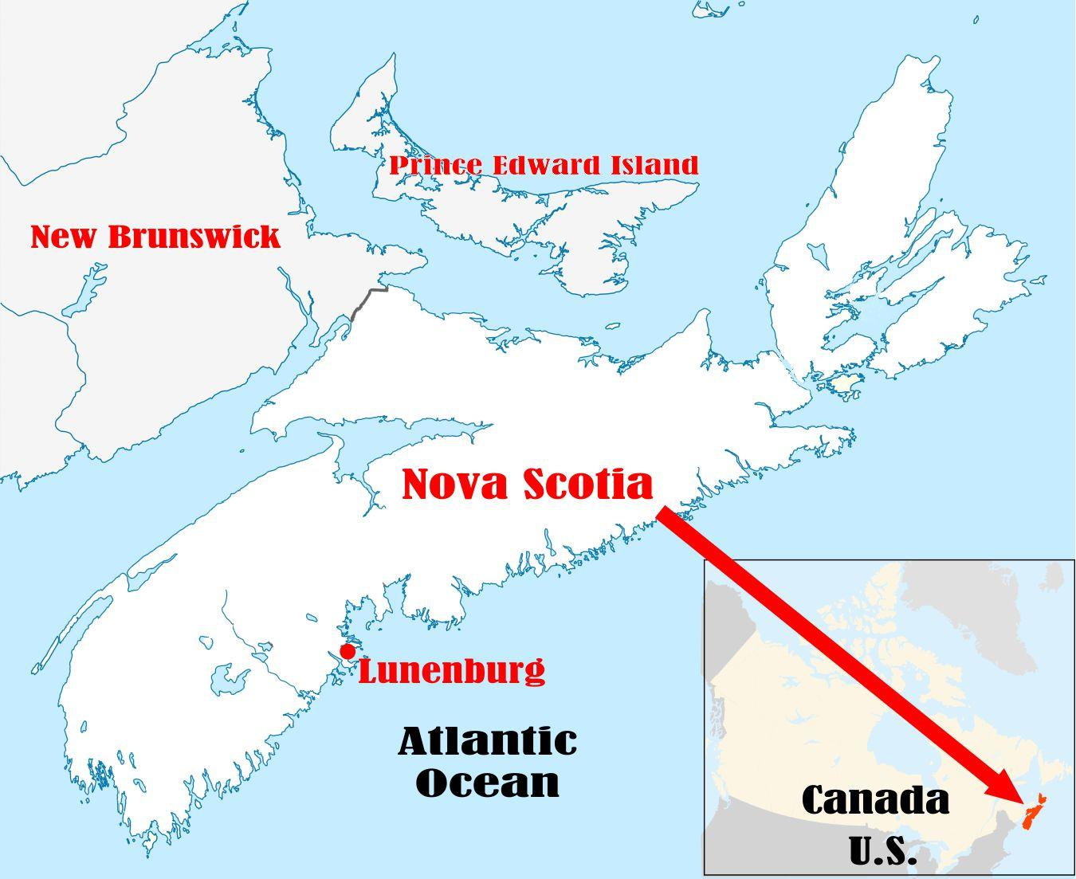

Slide 44
Nova Scotia
Virtually surrounded by ocean, it is connected to New Brunswick through a land bridge
Originally named Acadia by the French-- the descendents of the Acadians became the Cajuns of Louisiana.
Cape Breton causeway created to connect the island to Nova Scotia

Slide 45
Cape Breton Causeway
Has led to environmental challenges as it has disrupted the tidal regime, sedimentary disposition, and the natural ecosystem
Bobcat and Lynx populations have been displaced towards more isolated areas.

Slide 46
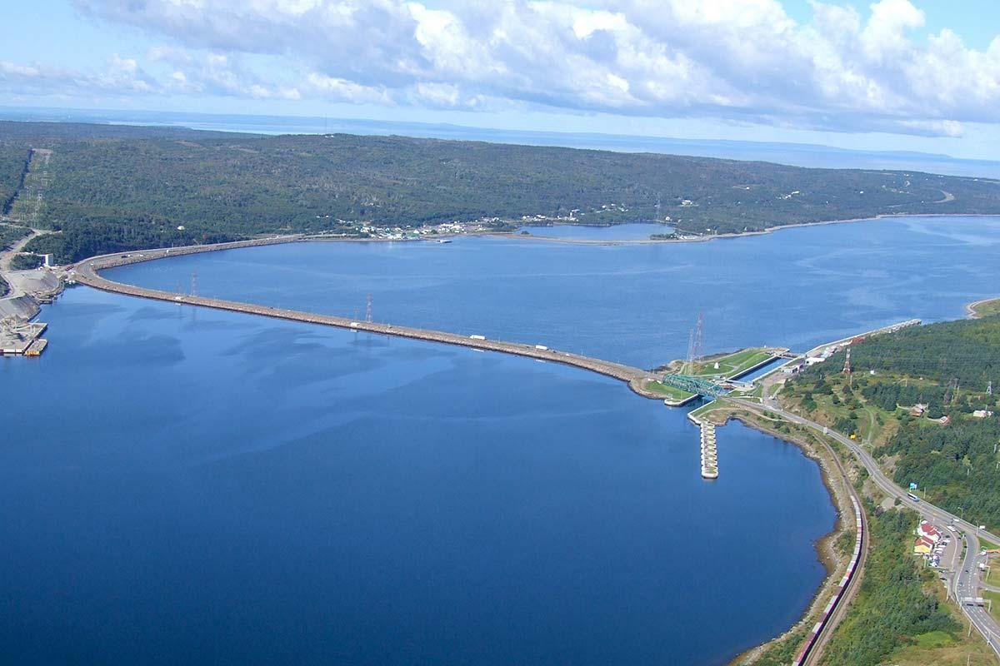

Slide 47
Nova Scotia Economy
Since the collapse of cod fishing and lumber, the Nova Scotian economy has shifted towards offshore oil and gas.
The region has also invested heavily into aerospace and defense.
4th largest film industry in Canada.

Slide 48
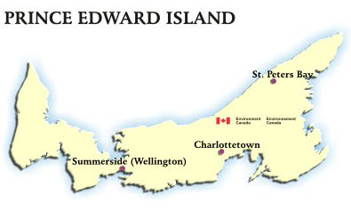
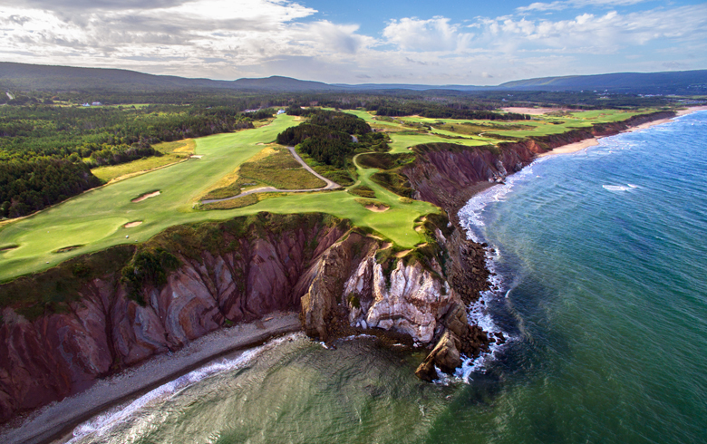
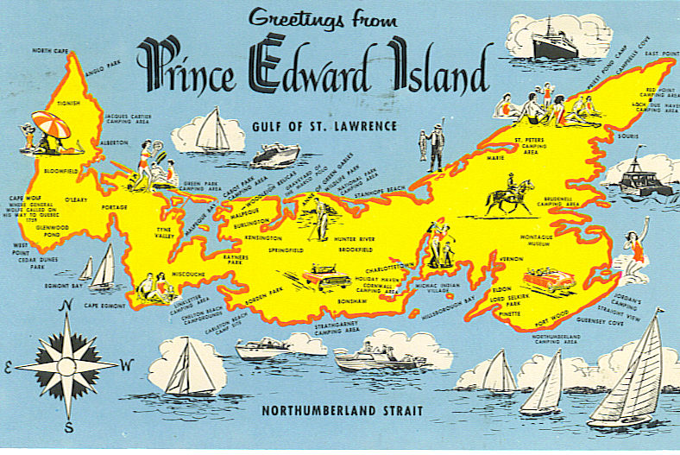
Prince Edward Island
The natural landscape is defined by mud flats, marshes, and red sand beaches.
Fertile sea coast prairies are reclaimed by the sea and used for farmland.

Slide 49
Prince Edward Island and
Sustainability
The 9 mile long Confederation Bridge connects the island to New Brunswick
The construction of the Bridge was done with consideration to terrestrial and aquatic life.
The provence is nicknamed the “Green Provence” due to its environmental initiatives such as endorsing wind turbines, biomass energy production, and high levels of recycling.

Slide 50
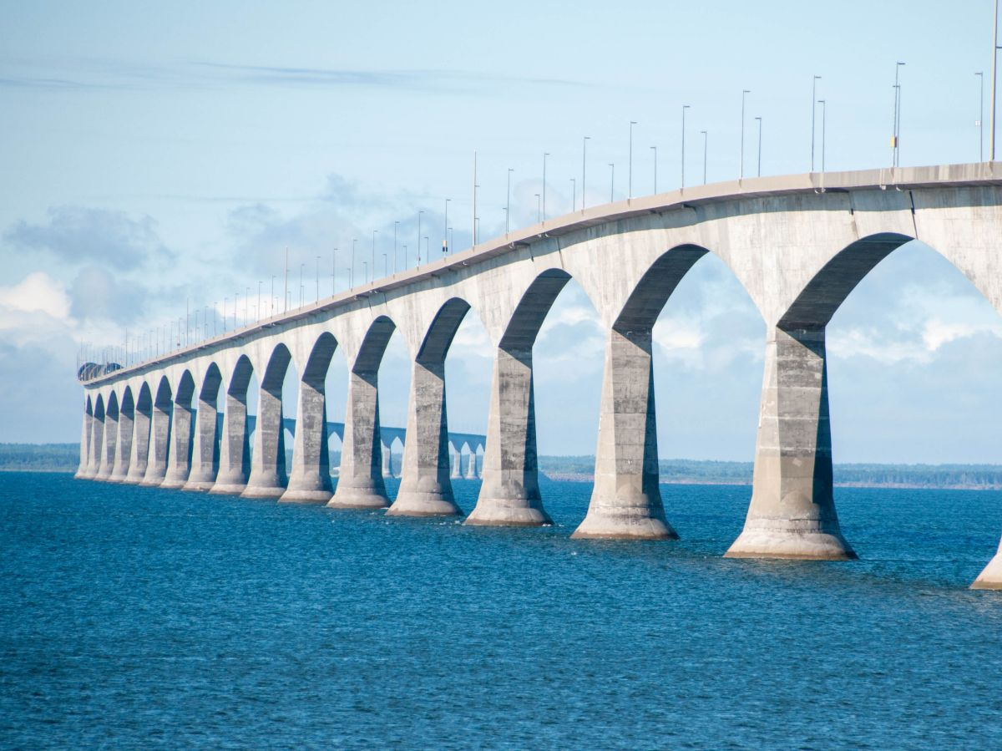

Slide 51
Prince Edward Island and Anne of Green Gables
One of the most famous people from PEI is author Lucy Maud Montgomery, a prolific author
In 1908, author L. M. Montgomery published Anne of Green Gables, the first novel in what became a series of eight novels that chronicled the life of Anne Shirley and her family on PEI
L. M. Montgomery was heavily inspired by PEI and described the island extensively in all her works
The Anne of Green Gables series became a literary phenomenon across the world
Today people continue to visit PEI to pay homage to L.M. Montgomery and her work
An Anne of Green Gables series is currently streaming on Netflix

Slide 52
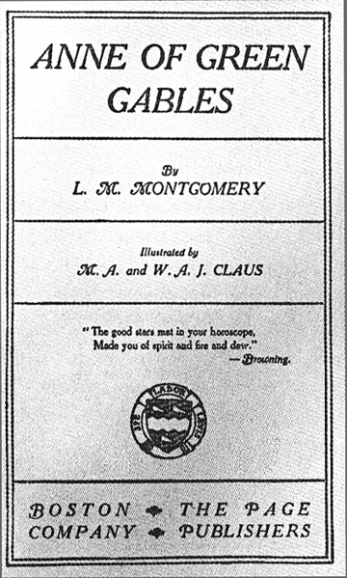


Slide 53


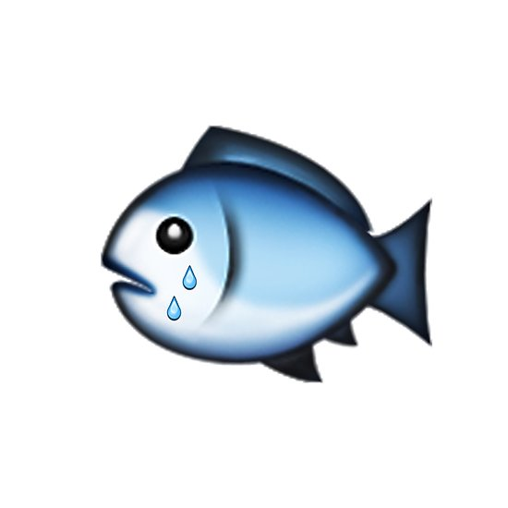
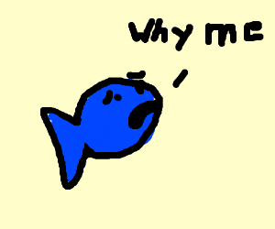
Essay Question
What led to the collapse of the fishing industry in the Atlantic provinces and what industries have the Atlantic provinces turned to in response?

Slide 54
Sources
“A Newfoundland Language Lesson with Mark Critch, Candice Walsh and Travel Yourself.”
YouTube, uploaded by Cailin O'Neil, 26 April, 2011,
https://www.youtube.com/watch?v=zqLuIXwsLDw&t=134s.
Mayda, Chris. A Regional Geography of the United States and Canada Toward a Sustainable
Future. Rowman & Littlefield, 2013.
Parry, Caroline. Biography of L.M. Montgomery. Anne of Green Gables, by L. M. Montgomery, 1908,
2nd ed., Bantam, 1998.
“The Grand Seduction.” IMDb, 2013, https://www.imdb.com/title/tt2319580/?ref_=nv_sr_1.
“THE GRAND SEDUCTION - OFFICIAL UK AND IRISH TRAILER [HD].” YouTube, Entertainment One
UK, 9 June, 2014, https://www.youtube.com/watch?time_continue=4&v=q17Vgb9HrSY.
“The Night Pat Murphy Died-Great Big Sea.” YouTube, uploaded by CTCeltics, 23 August, 2009,
https://www.youtube.com/watch?v=q7Bsb-8pxG8.

Slide 55
Academic Journal Sources
https://csulb-primo.hosted.exlibrisgroup.com/primo-explore/fulldisplay?docid=TN_proquest851481797&context=PC&vid=01CALS_ULB&lang=en_US&search_scope=PRIMO_CENTRAL&adaptor=primo_central_multiple_fe&tab=articles&query=any,contains,Fishing%20industry&sortby=rank&offset=0
United states: Those in peril off the sea; new england's fishing industry. (2011, Feb 12). The Economist, 398, 38. Retrieved from http://csulb.idm.oclc.org/login?url=https://search.proquest.com/docview/851481797?accountid=10351
New Bedford is the nation's principal fishing port in terms of landed value. To prevent overfishing and to allow fish stocks to rebuild, federal officials set up a new regulation system last year. Many fishermen think the new limits are unreasonably low. Two-thirds of New Bedford's boats have not left harbour since August.
https://search.proquest.com/docview/213575718?accountid=10351&rfr_id=info%3Axri%2Fsid%3Aprimo
Greene, K. (2002). Bigger populations needed for sustainable harvests. Science, 296(5571), 1229-30. Retrieved from http://csulb.idm.oclc.org/login?url=https://search.proquest.com/docview/213575718?accountid=10351
The future of the New England fishing industry rests on the willingness of fishers, environmentalists, scientists, and the courts to find common ground. Scientists hope to replicate the success of a New England Fishery Management Council plan that helped restore the area's scallop industry with similar calculations for the much larger groundfish industry.

